Slide 1

UE19CS204 – Web Technologies Mini Project
PROJECT TITLE – FOOD RECIPE WEBSITE
-

Slide 2
Section – B Team Member Names – Team member SRNs Beru Neha PES2UG19CS084 Dhanawada Lasya Priya PES2UG19CS111 Deepali Suraj Attavar PES2UG19CS106
GITHUB Link:
https://github.com/lasya-priya-d/recipe-app

Slide 3
Abstract
This is a website created by us for cooking enthusiasts. Our user can save and review previously saved recipes. This will be their very own cookbook, containing steps, difficulty level, duration time and images of the recipes uploaded by them respectively.
The reason for choosing this project is because the features looked interesting and relatable, few aspects looked challenging enough whereas the other features looked practically achievable.
We used MERN stack (MongodB, Express, React, Node) for building our project.

Slide 4
Technologies Used
(include Additional modules/libraries used)
In database
Mongoose- Mongoose provides a straight-forward, schema-based solution to model the application data.
In server-end
Cors - Cross-Origin Resource Sharing (CORS) is an HTTP-header based mechanism that allows a server to indicate any other origins (domain, scheme, or port) than its own from which a browser should permit loading of resources.
Method-override - Lets you use HTTP verbs such as PUT or DELETE in places where the client doesn't support it.

Slide 5
Member Contributions
(Functionality worked on by each team member)
All the members helped each other out but majorly worked on the below functionality respectively.
Deepali Suraj Attavar -Front end
Dhanawada Lasya Priya - Front end and Database
Beru Neha - Server end

Slide 6
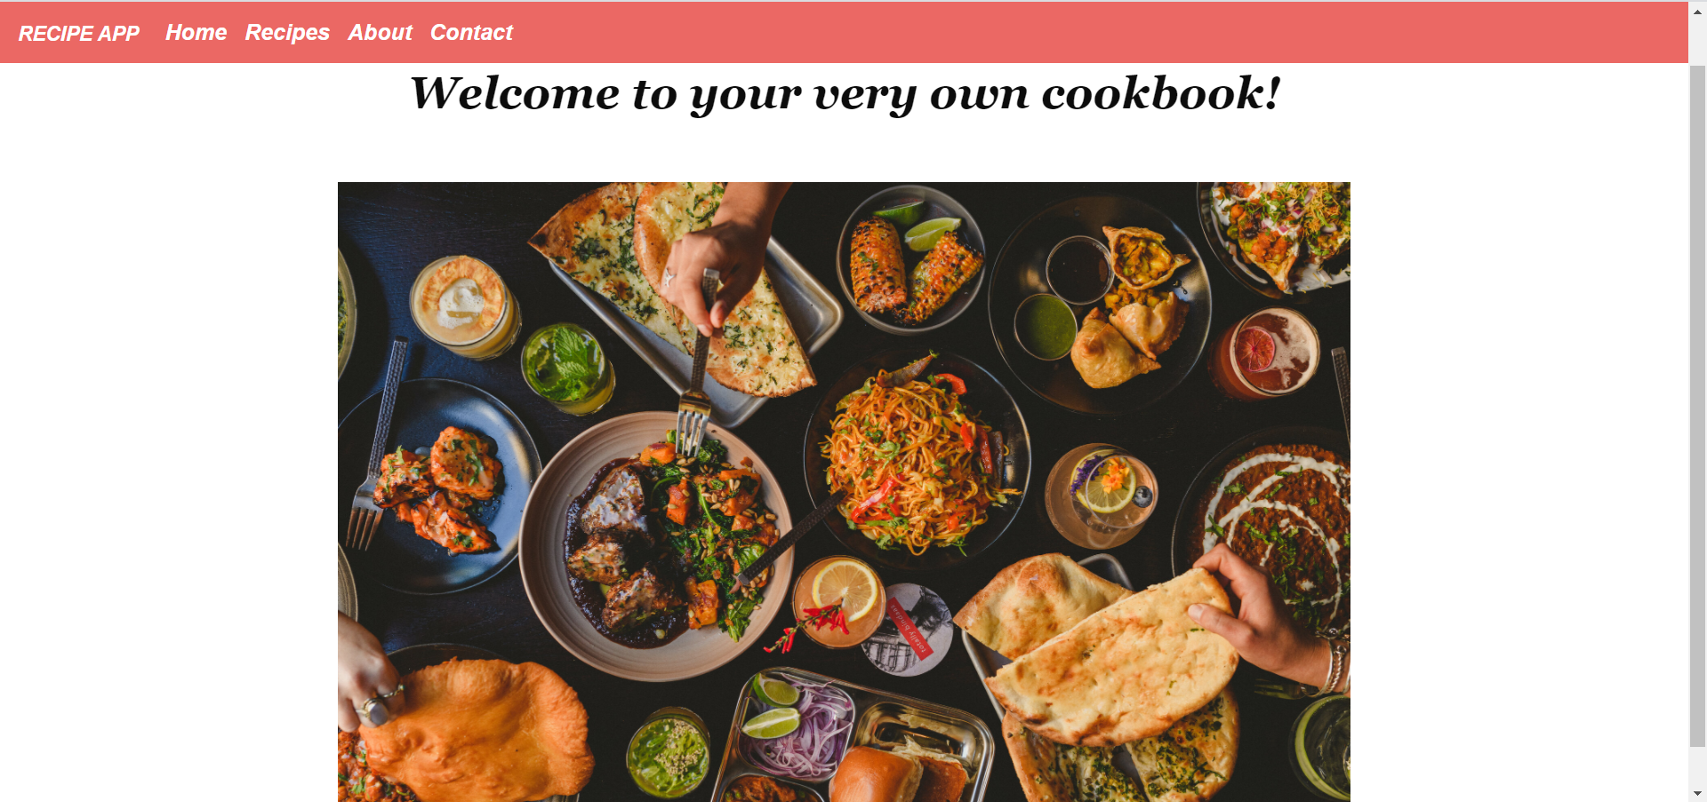
SCREEN SHOTS OF THE WEBSITE
HOME PAGE

Slide 7
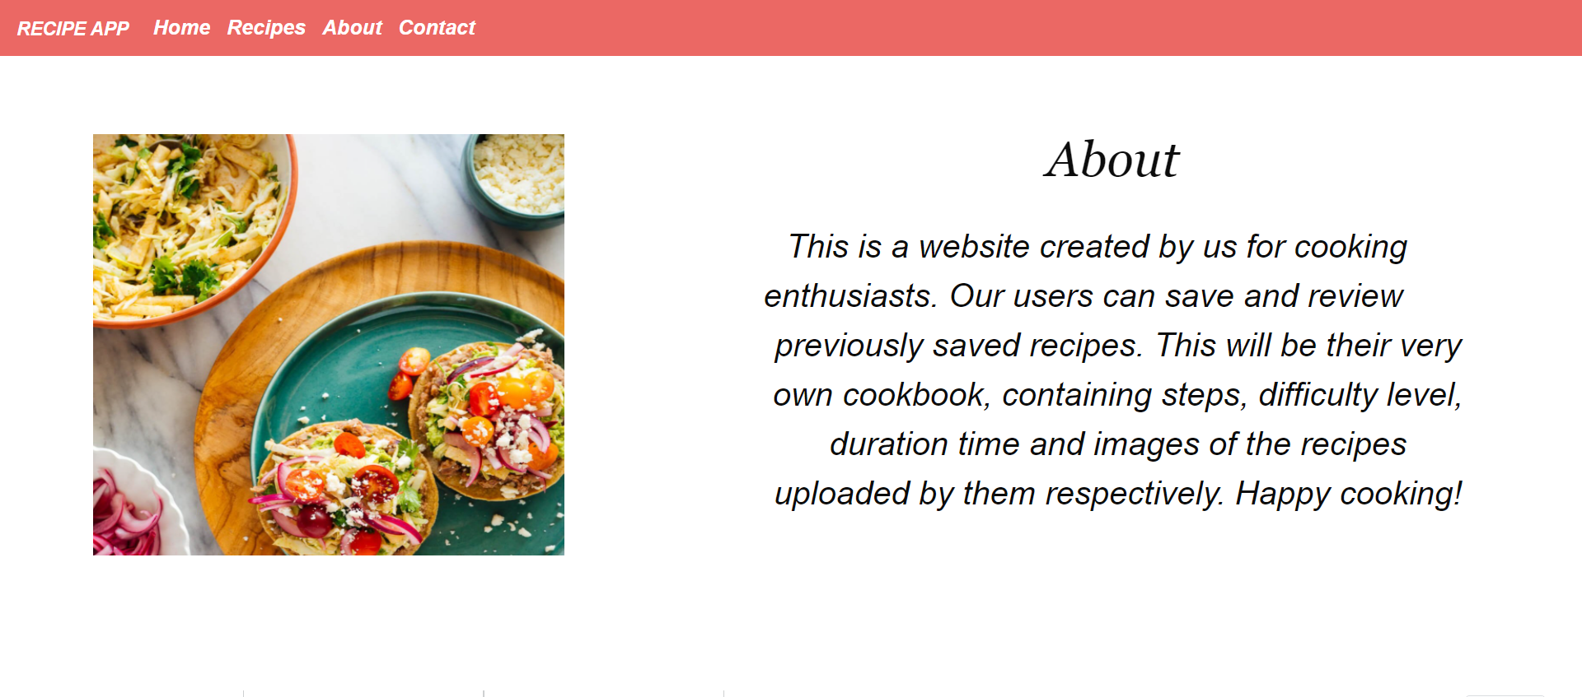
ABOUT OUR WEBSITE

Slide 8
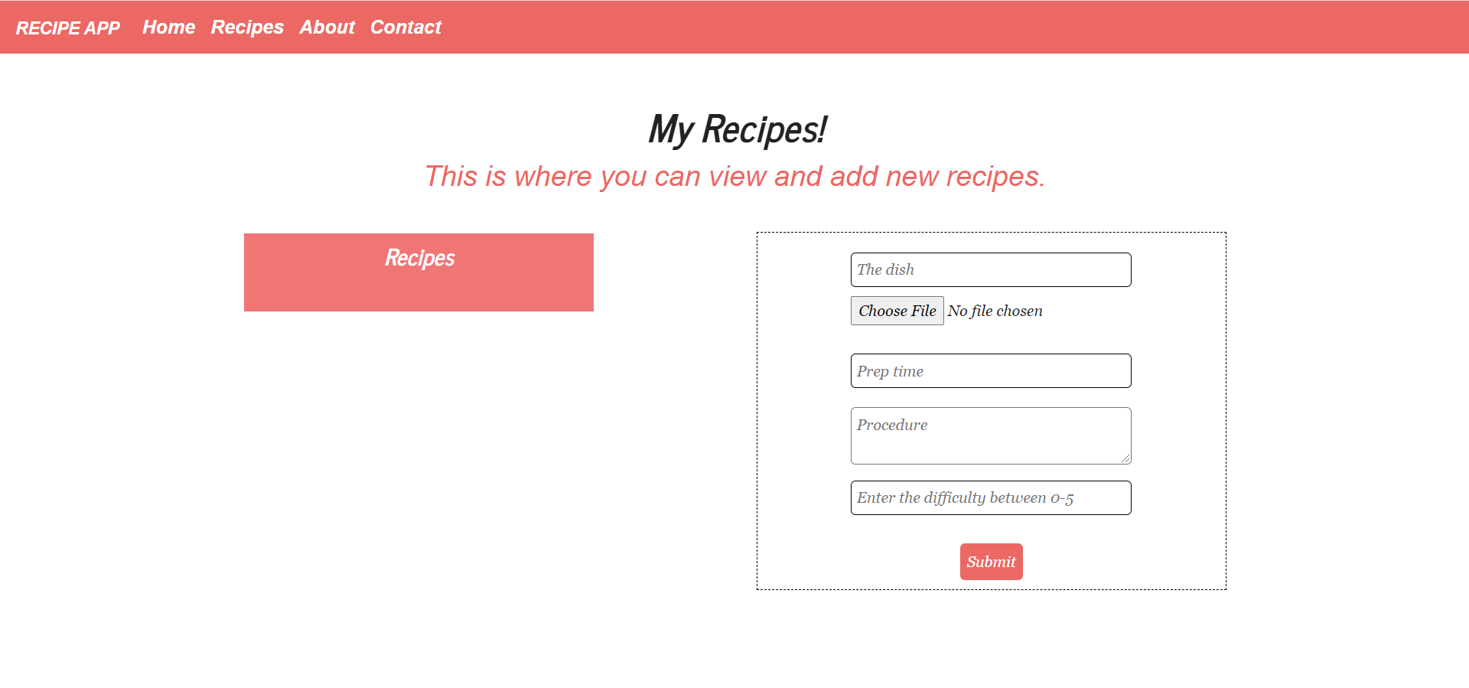
BASIC VIEW OF THE RECIPES TAB

Slide 9
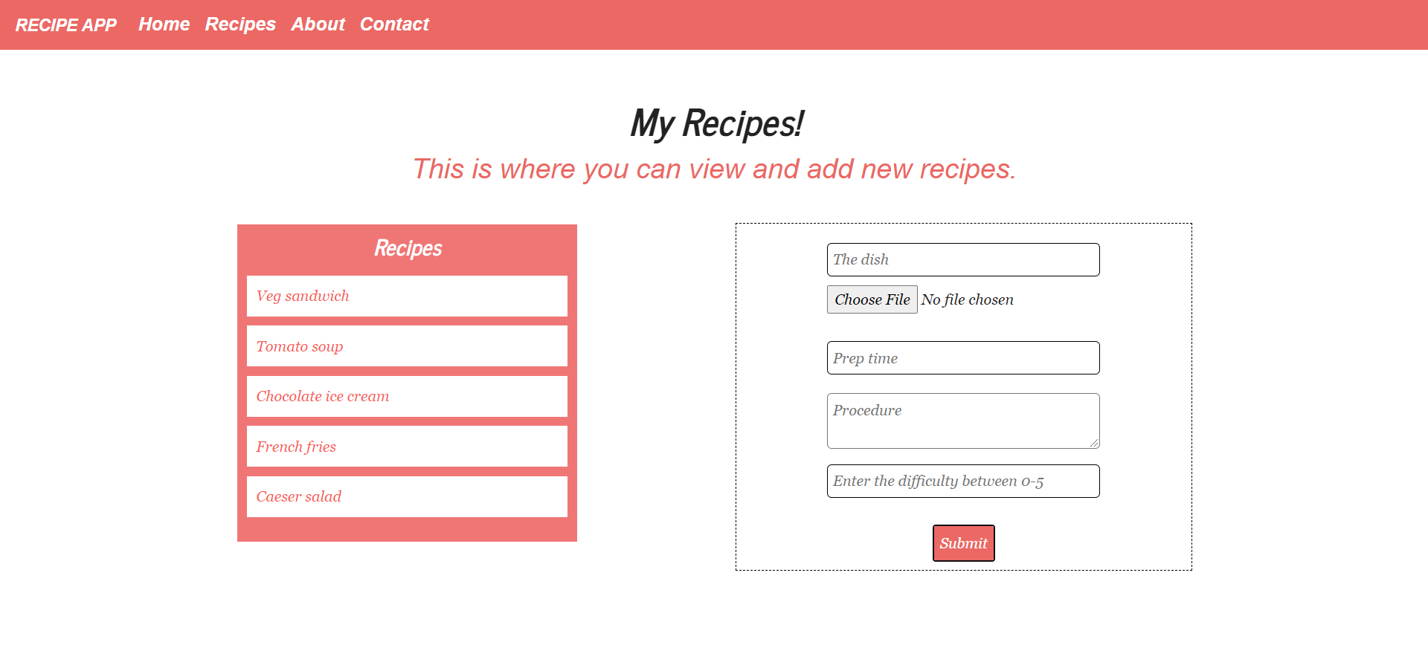
RECIPES TAB WITH A FEW ADDED RECIPES

Slide 10
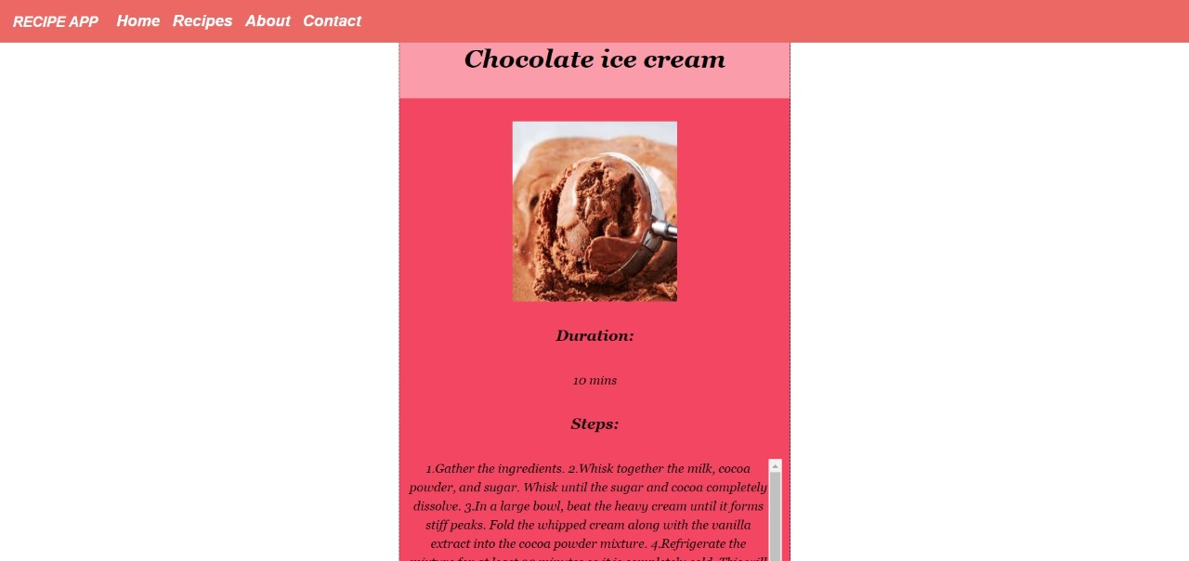
A RECIPE WHEN OPENED

Slide 11
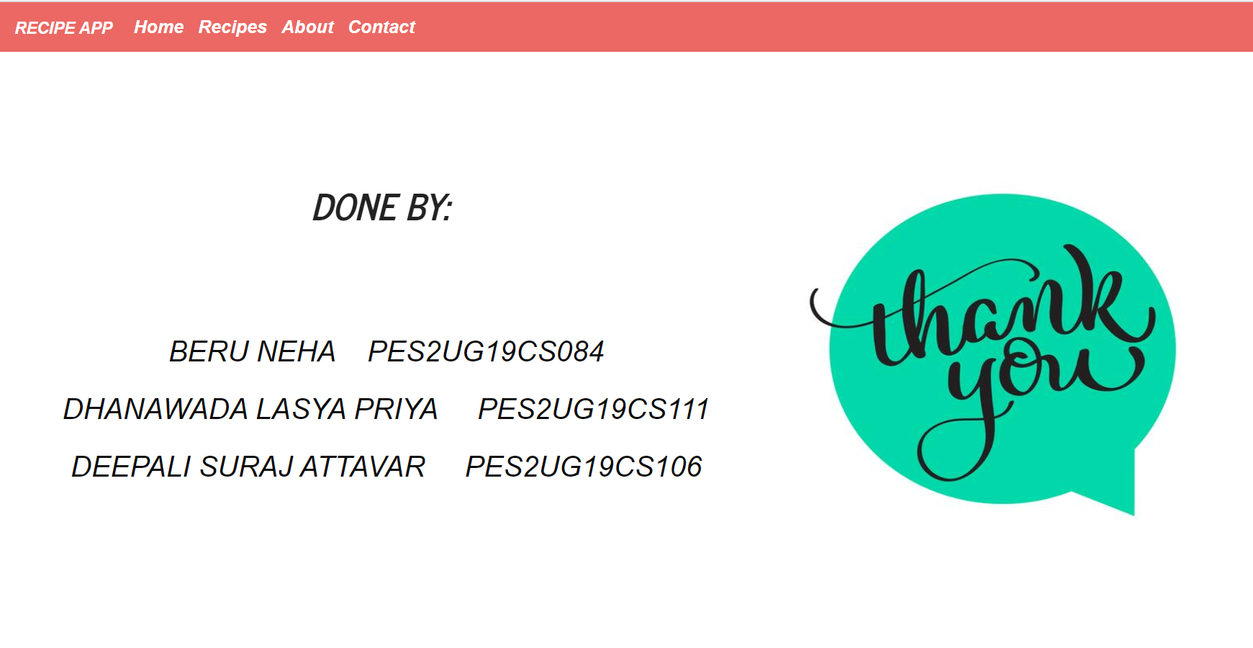
STUDENT DETAILS

Slide 12


